Slide 1


SyriaTel Customer Churn Analysis

Slide 2
Overview
Syriatel, a telecommunications company, faces the challenge of customer churn, impacting its revenue and growth. This analysis aims to predict churn and provide actionable insights to retain customers.

Slide 3



Business and Data Understanding
Problem Statement
Objective
Data Used
Identify patterns and factors associated with customer churn.
Predict churn to implement targeted retention strategies.
SyriaTel customer data including demographics, usage patterns, and service details.

Slide 4



Exploratory Data Analysis
Data Structure
Univariate Analysis
Bivariate Analysis
3,333 records, 20 features
Distribution of features by churn status
Churn rates across states

Slide 5
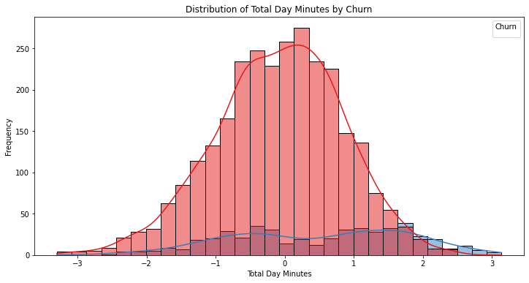
Total Day Minutes Distribution Analysis: Churn vs. Non-Churned
Churned customers show lower total day minutes.
Non-churned customers tend to have higher total day minutes.

Slide 6
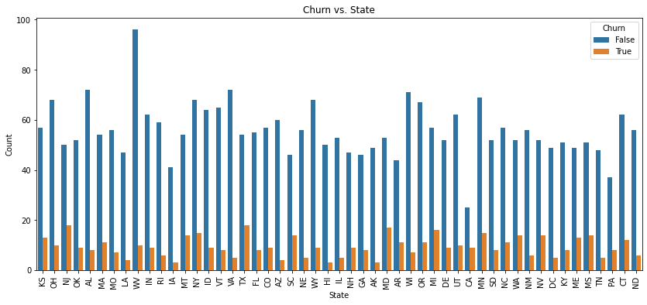
Churn Rate Analysis by State
Higher Churn Rates: Some states have more churned customers, indicating higher churn rates.
Lower Churn Rates: Other states show more non-churned customers, suggesting lower churn rates.
Regional Patterns: Neighboring states may display similar churn behavior due to market dynamics or demographics.
Outliers: Certain states stand out with exceptionally high or low churn rates, warranting further investigation.

Slide 7


Modeling and Evaluation
Models Used
Logistic Regression, Random Forest
Model Evaluation
Best Performer
Accuracy, Precision, Recall.
Random Forest

Slide 8

Feature Importance
Top Contributing Factors for Random Forest:
Total Day Charge
Total Day Minutes
Customer Service Calls
International Plan
Total Evening Minutes

Slide 9
Recommendations
Optimize pricing plans and service quality during peak hours.
Improve customer service experiences and resolution time.
Tailor offerings for customers with international calling needs.
Offer competitive pricing for evening usage.
Analyze international calling patterns for better satisfaction.

Slide 10




Next Steps
Implement Random Forest model for churn prediction.
Segment customers based on behavior and preferences.
Continuously monitor churn rates and model performance.
Establish a feedback loop to gather customer insights.

Slide 11



Thank You
Shuru Ebale
+254 - 446 - 832
shuruxebale@gmail.com

